Slide 1
Text Analysis

Slide 2
Introduction
Context is important when working with text.
A good source for movies information: The Internet Movie Database(IMDb)
The tagline file: 100 years of movie tagline information from IMDb

Slide 3
Movie tagline
What is a move tagline?
One or more comments, phrases, or sentences
Linked to movie title and used on movie posters and covers
Included in advertising copy and encourage people to watch the movie
Source of text describing the movie

Slide 4
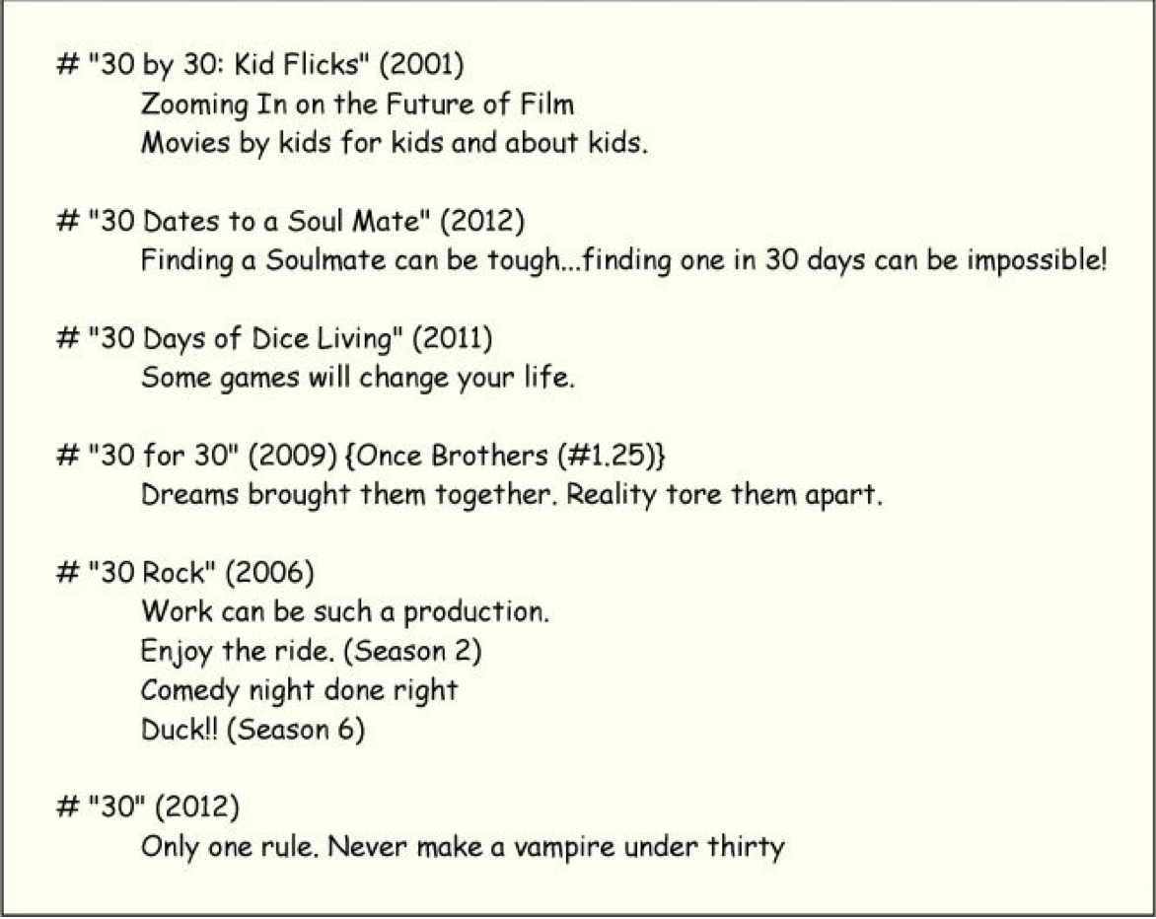
Movie tagline

Slide 5
Text Analysis Goal
Text needs to be processed before it can be analyzed.
Text files are typically unstructured, which makes processing challenging.
Impose structure on text before analyzing or modeling it
So far we have done predictions using numbers.
In text analytics the raw input is words and not numbers.
Context, order of words, words combinations and the meaning of words are important.
The first challenge is to turn words into numbers for analysis.

Slide 6
Movie Tagline Data set
IMDb tagline file represents partially structured text
Each observation represents a movie and begins with #
Movie titles are enclosed in quotes.
Dates are enclosed in parenthesis after movie title.
Tagline doesn’t have any format and may include various punctuations
Comments are enclosed in curly brackets
What happens when you try to read data in R and text has single/double quotes?
Goal is to examine trends in movies over the years
Date is important information
Each item is identified by a merged character string of the movie title and date
Eg Invasion of the body snatchers (1956), Invasion of the body snatchers (1978)

Slide 7
Movie Tagline Data set
Tag:in text analytics refers to information associated with a text document
Date of release is a tag
It provides information about the document but is not part of the text document itself.
Genre would have been another such tag.
Tag is also referred as document’s “metadata”

Slide 8
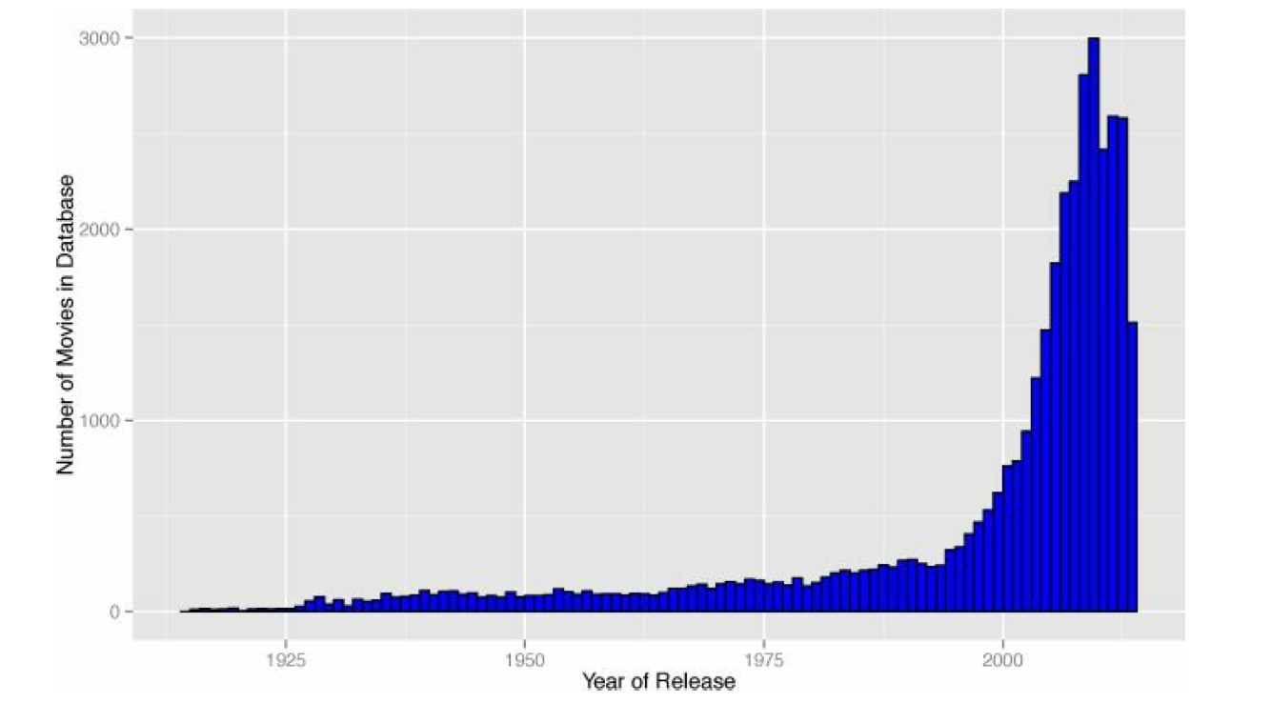
Movie Tagline Data set
Distribution of release dates in the movie taglines data

Slide 9
Text Analysis – Step One
Bag – of – words approach
One document for each of the forty years
Combine the taglines from all movies released in a year
It ignores the meanings of taglines, and the order of words or combination of words. Hence it is different from Natural Language Processing approach where such meanings and order are not ignored.
Considers each word as an individual item for analysis.
The yearly documents are bags of words
Corpus: forty documents, one for each year from 1974 to 2013
No blank characters or whitespace
All lowercases
Remove numbers, punctuation marks, pronouns, stop words, and common verbs such as is, has, etc.

Slide 10
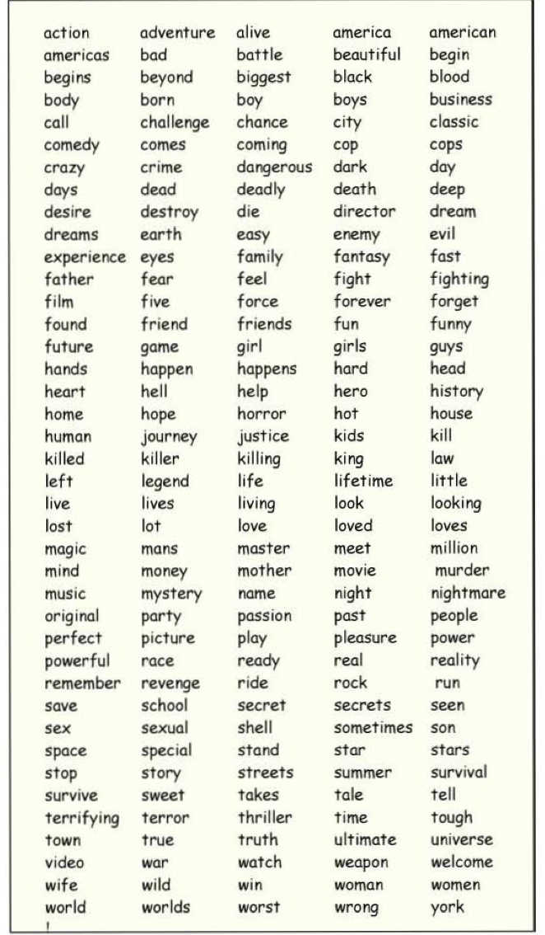
Bag of 200 words

Slide 11
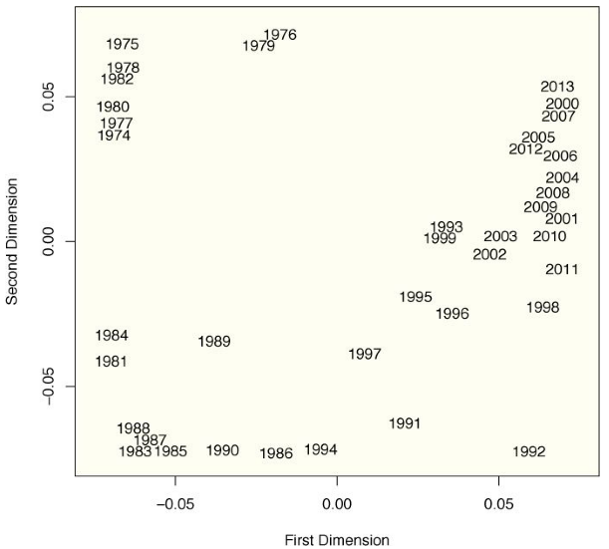
Corpus across time
Compute the degree to which tagline documents differ from one year to the next. In particular, compute a distance-matrix between all pairs of document years
Using these distances, create a picture of the corpus through time.

Slide 12
Observations from the previous plot
Documents from the 1970s are at the top center
Documents from the most recent years are at the top right-hand side of the plot
Documents closer in time are closer to one another in the space displayed
Conclusion: There are time trends in these text data
Trivia: The picture is obtained by a multivariate method known as multidimensional scaling

Slide 13
Identify different clusters of words
How have movies changed across the years?
Terms-by-documents matrix
In each year, different terms occur in different percentage
different clusters of years use certain terms more than others
identify five common groups or clusters of words, defining text measures that we call LOVED, WORLDS, TRUTH, LIFE, and STORY.
For this analysis, each text measure was computed as the percentage of words in a document that match any of the top three words in the cluster (that is, the word defining the cluster and the two words closest to that word). It would be preferable to have more words in the definition of each text measure.
Principal components biplot

Slide 14
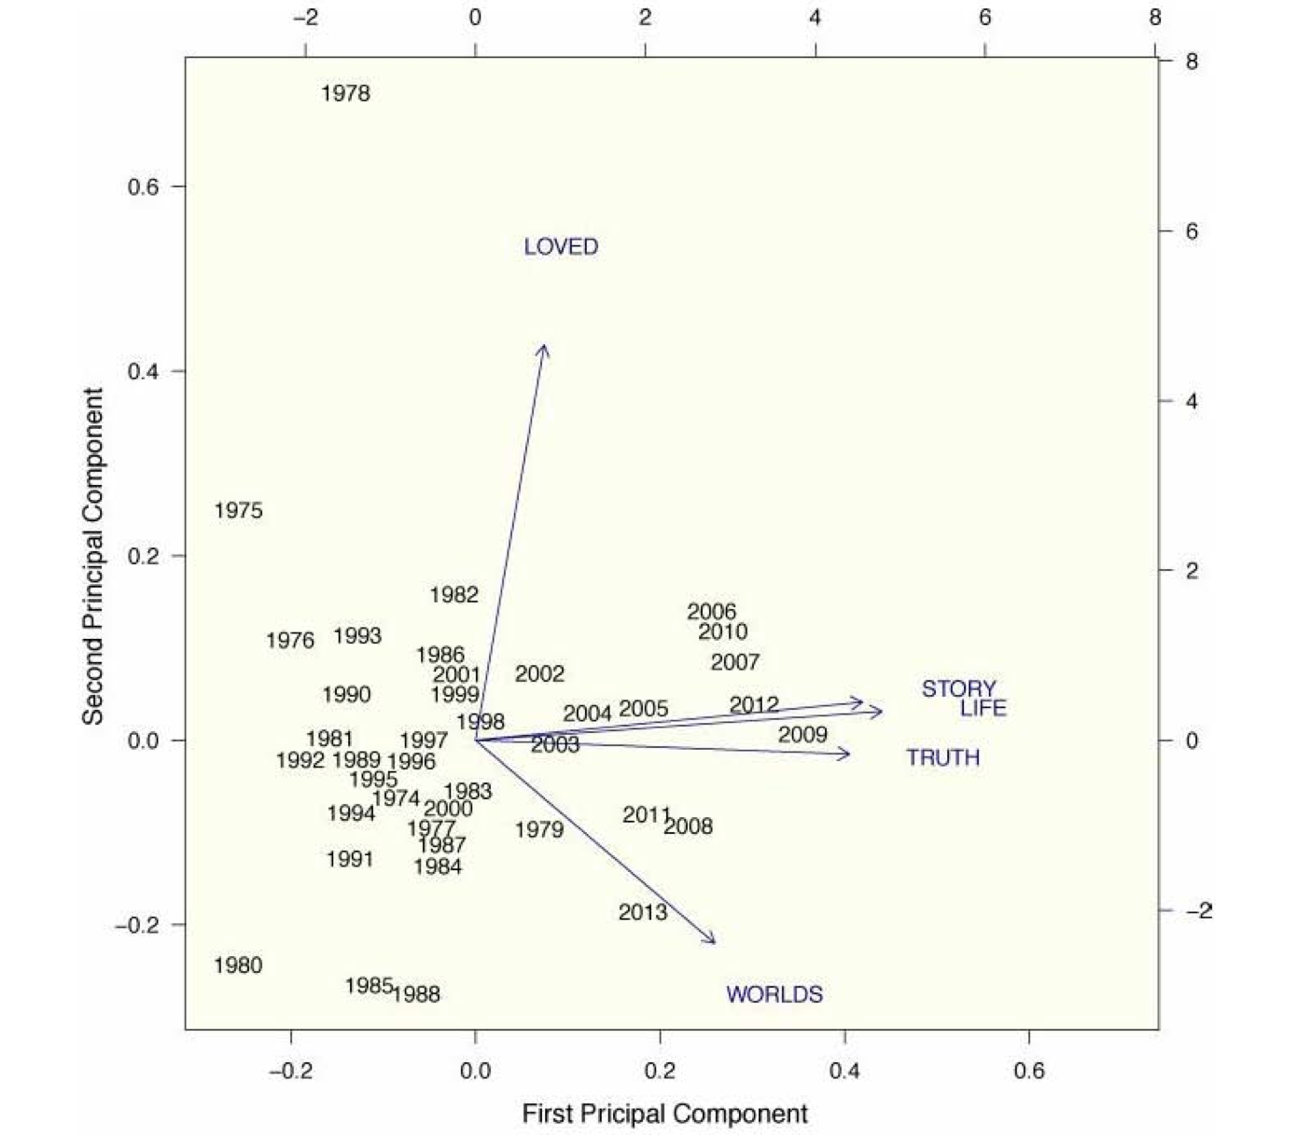
Principal components bi-plot

Slide 15
Text Analysis
What is it about movies that makes them so different from one decade to the next？
A shift in the words used to describe movies.
A shift towards true-to-life stories
Disciplines that text analytics draws from:
Linguistics, communication and language arts, experimental psychology, political discourse analysis, journalist, computer science and statistics

Slide 16
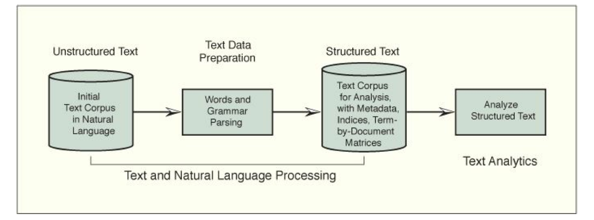
Commonly used 2 ways of text analysis
Bag of words
Natural language processing

Slide 17
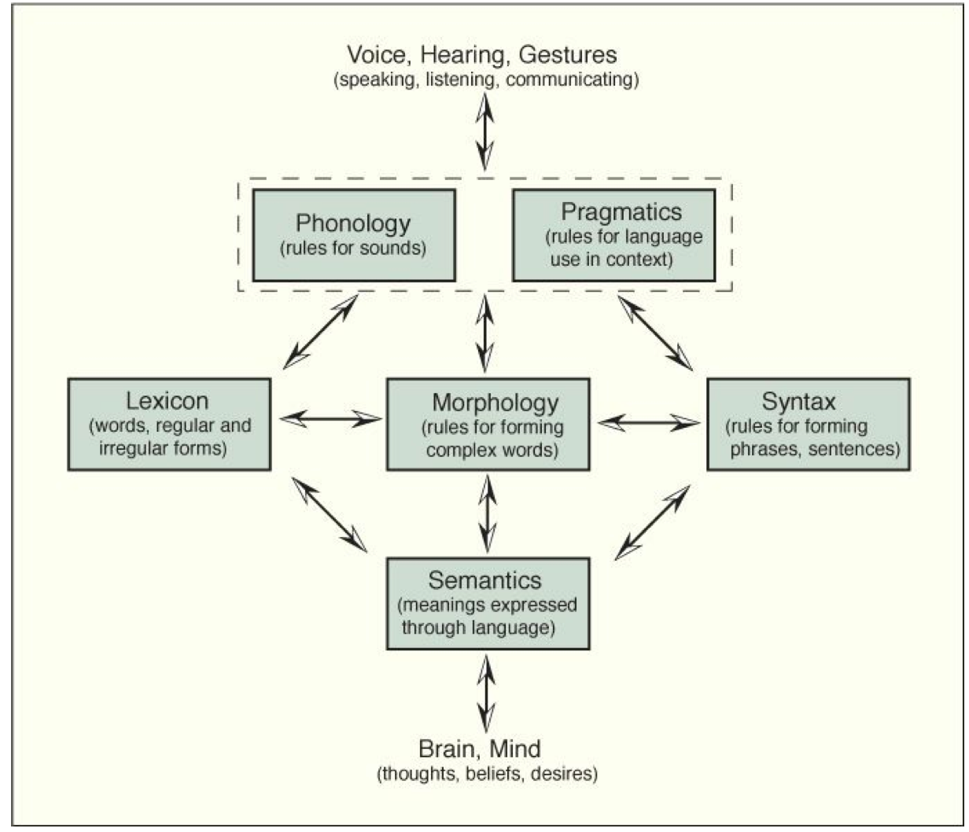
Natural Language comprises
“Generative grammar” is a general term for the rules; “morphology”, “syntax,” and “semantics” are more specific terms.
Computer programs for NLP use linguistic rules to mimic human communication and convert natural language into structured text for further analysis.

Slide 18
Natural Language Processing
Natural Language Processing:
Broad area of academic and an important area of computational linguistics
High frequency words/ collections of words that mean something special
Words relating to the same concept or word stem
Syntactic structures/sequences of words that form terms
Terms- by-documents matrix (aka lexical table)
contains words/word-stems in rows and documents are in columns.
Cells contain frequency count
Very low frequency terms, those used in few documents, are dropped from the terms-by-documents matrix, reducing the number of rows in the matrix.

Slide 19
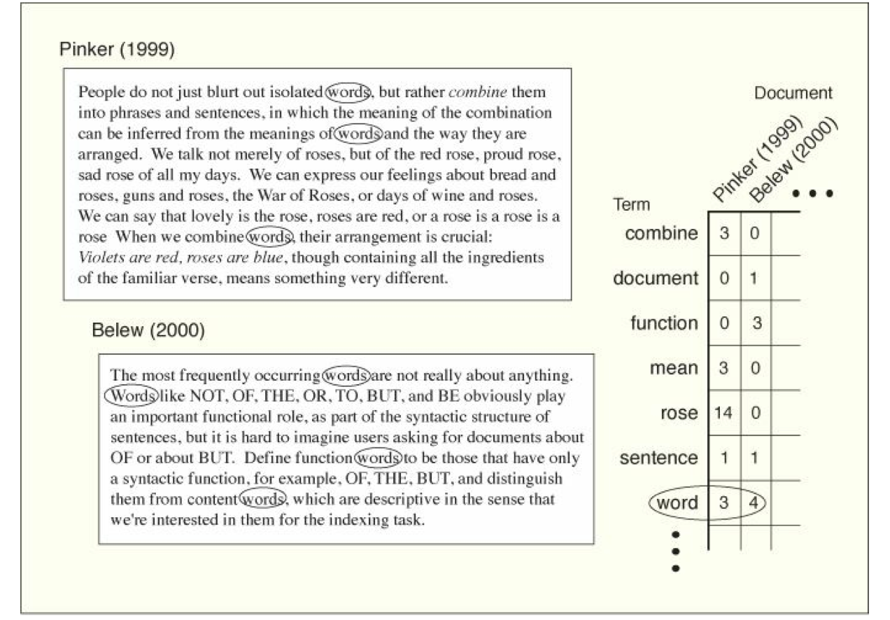
Terms-by-documents matrix

Slide 20
Text Analytics Problems
Unsupervised text analytics problems
No response or class to be predicted
Identify common patterns or trends in the data
Define text measures describing the documents in the corpus
Supervised text analytics problems
A response or class of documents to be predicted
Text classification problems eg spam or not
Information retrieval, search engines classify documents
Techniques: Logistic regression, linear discriminant function analysis, classification trees and support vector machines
Automatic text summarization
Help with information management
Recognize common text strings associated with user requests

Slide 21
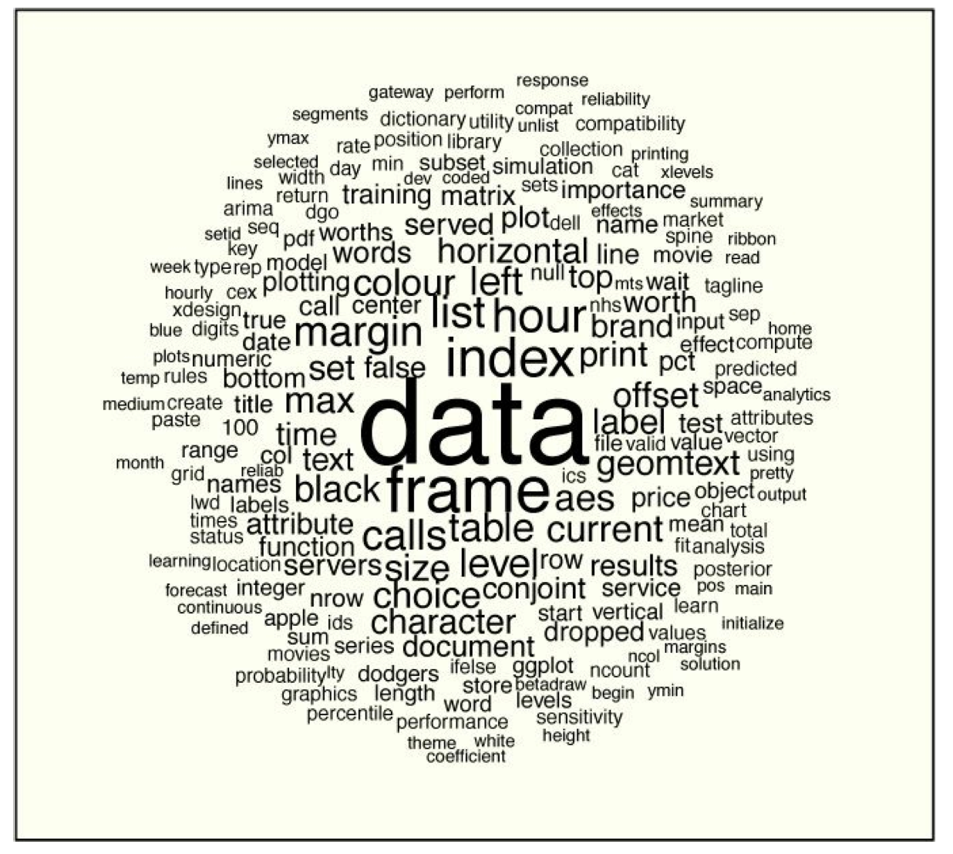
An R Programmer’s Word Cloud

Slide 22
Code
There is initial data preparation, parsing of the partially structured text data.
These parsed data were used to define the corpus.
Text measures are scores on attributes that describe text.
Text measures are computed on the corpus.
Results are presented using multivariate methods for data visualization.
The program ends with the word cloud.

Slide 23
How to run the code?
Extract ch7.zip from Canvas
Open the file ch7.txt
Set the path inside function setwd(). Setwd sets the working directory for the code.
First just run the library commands from the ch7.txt in R console. Install all the missing packages by using command
Install.packages(“missingPackage”)
Copy the code from ch7.txt and paste it in R-console/R-commander
This folder has
Code file: ch7.txt
Data
an appendix_c3_program.R which has a function used by the code.

